Slide 1
S.P.Y.C.A.T
Smart Pet You Care About Tons
Notes:
arnold

Slide 2




L2B group 15
Arnold Ying |  | Stella Wang
Rain Zhang |  | Yisheng Liu

Slide 3



Project Inspiration
Notes:
arnold
SPYCAT is a virtual pet system built with a De1-SoC FPGA board. Its aim is to improve the user’s quality of life by providing companionship and virtual interaction with friends.

Slide 4
Project overview
Notes:
arnold

Slide 5

Notes:
rain

Slide 6
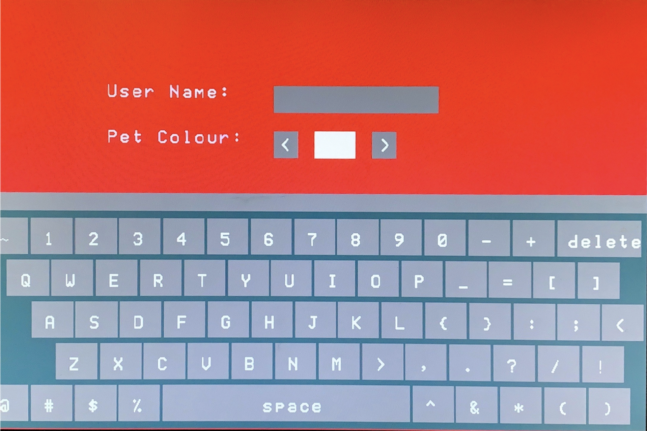
Notes:
yisheng

Slide 7
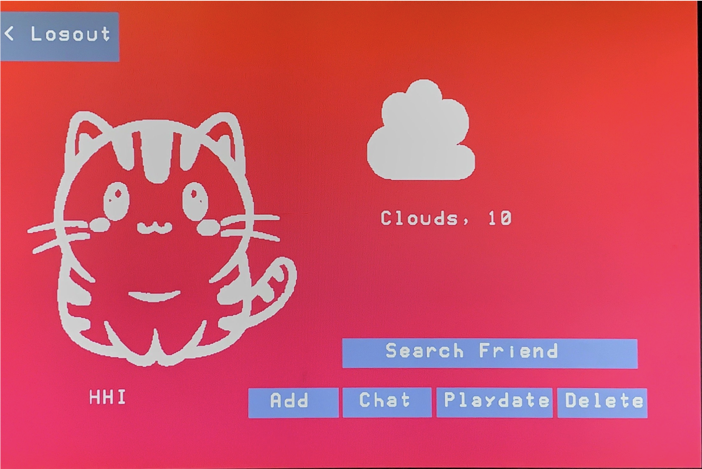
Notes:
arnold

Slide 8
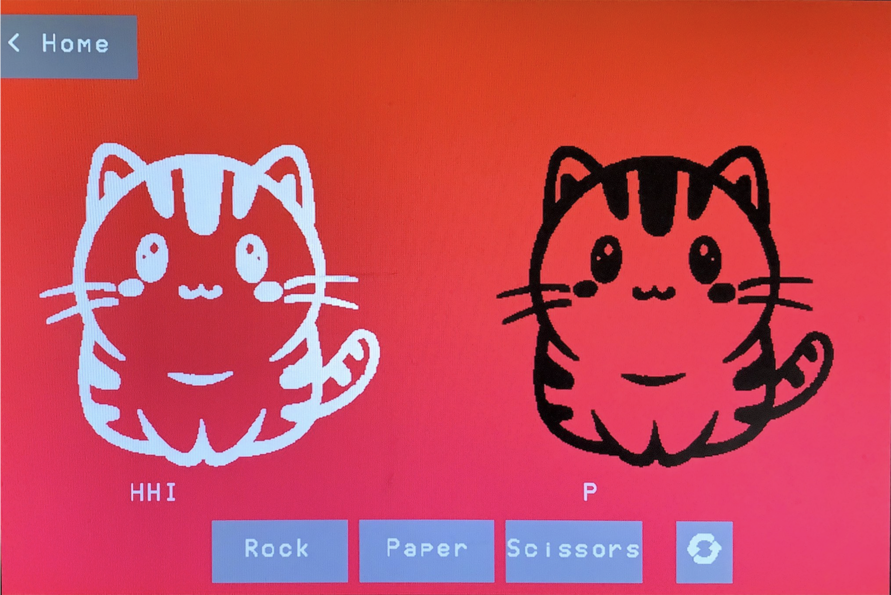
Notes:
stella
friendship_points

Slide 9
Schematics

Slide 10
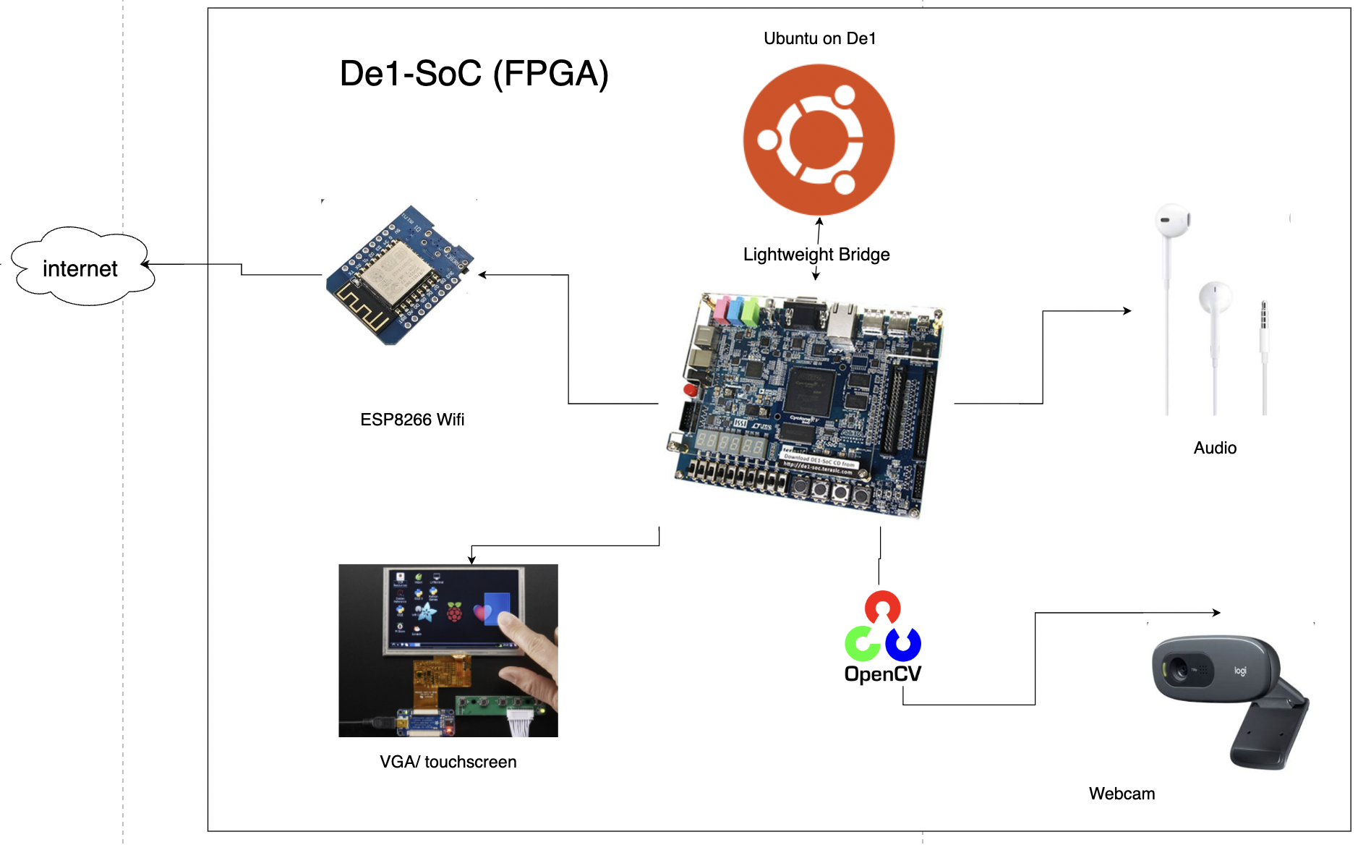
Hardware
Notes:
arnold

Slide 11
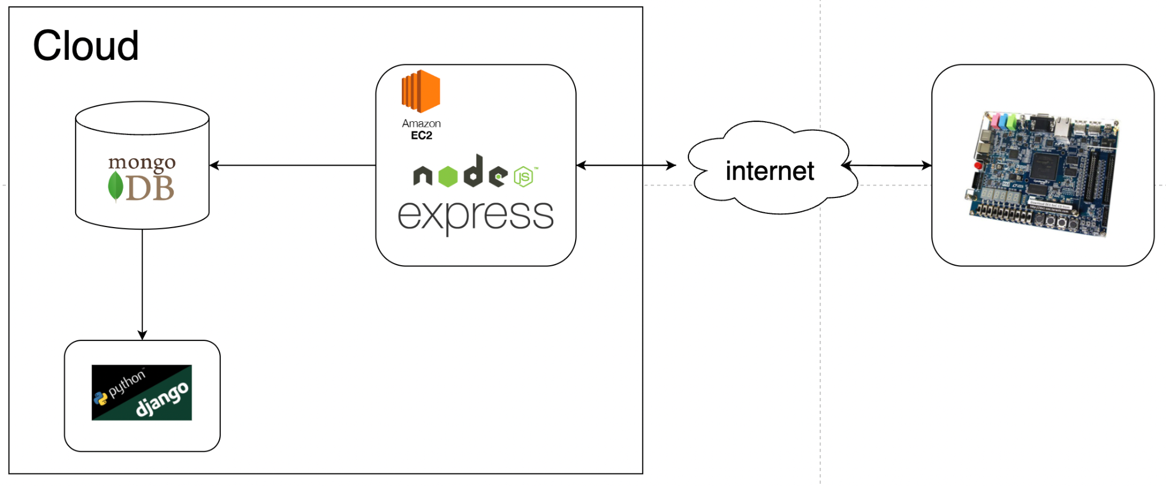


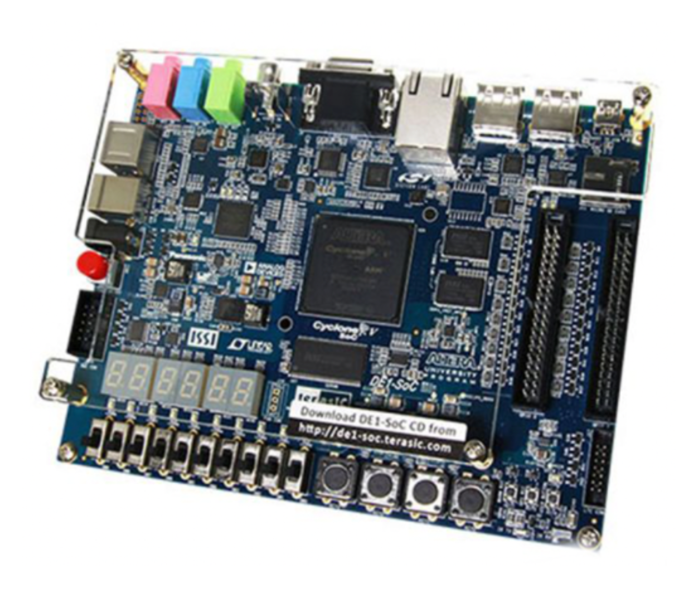


Software
Database
Website Frontend
Notes:
stella

Slide 12
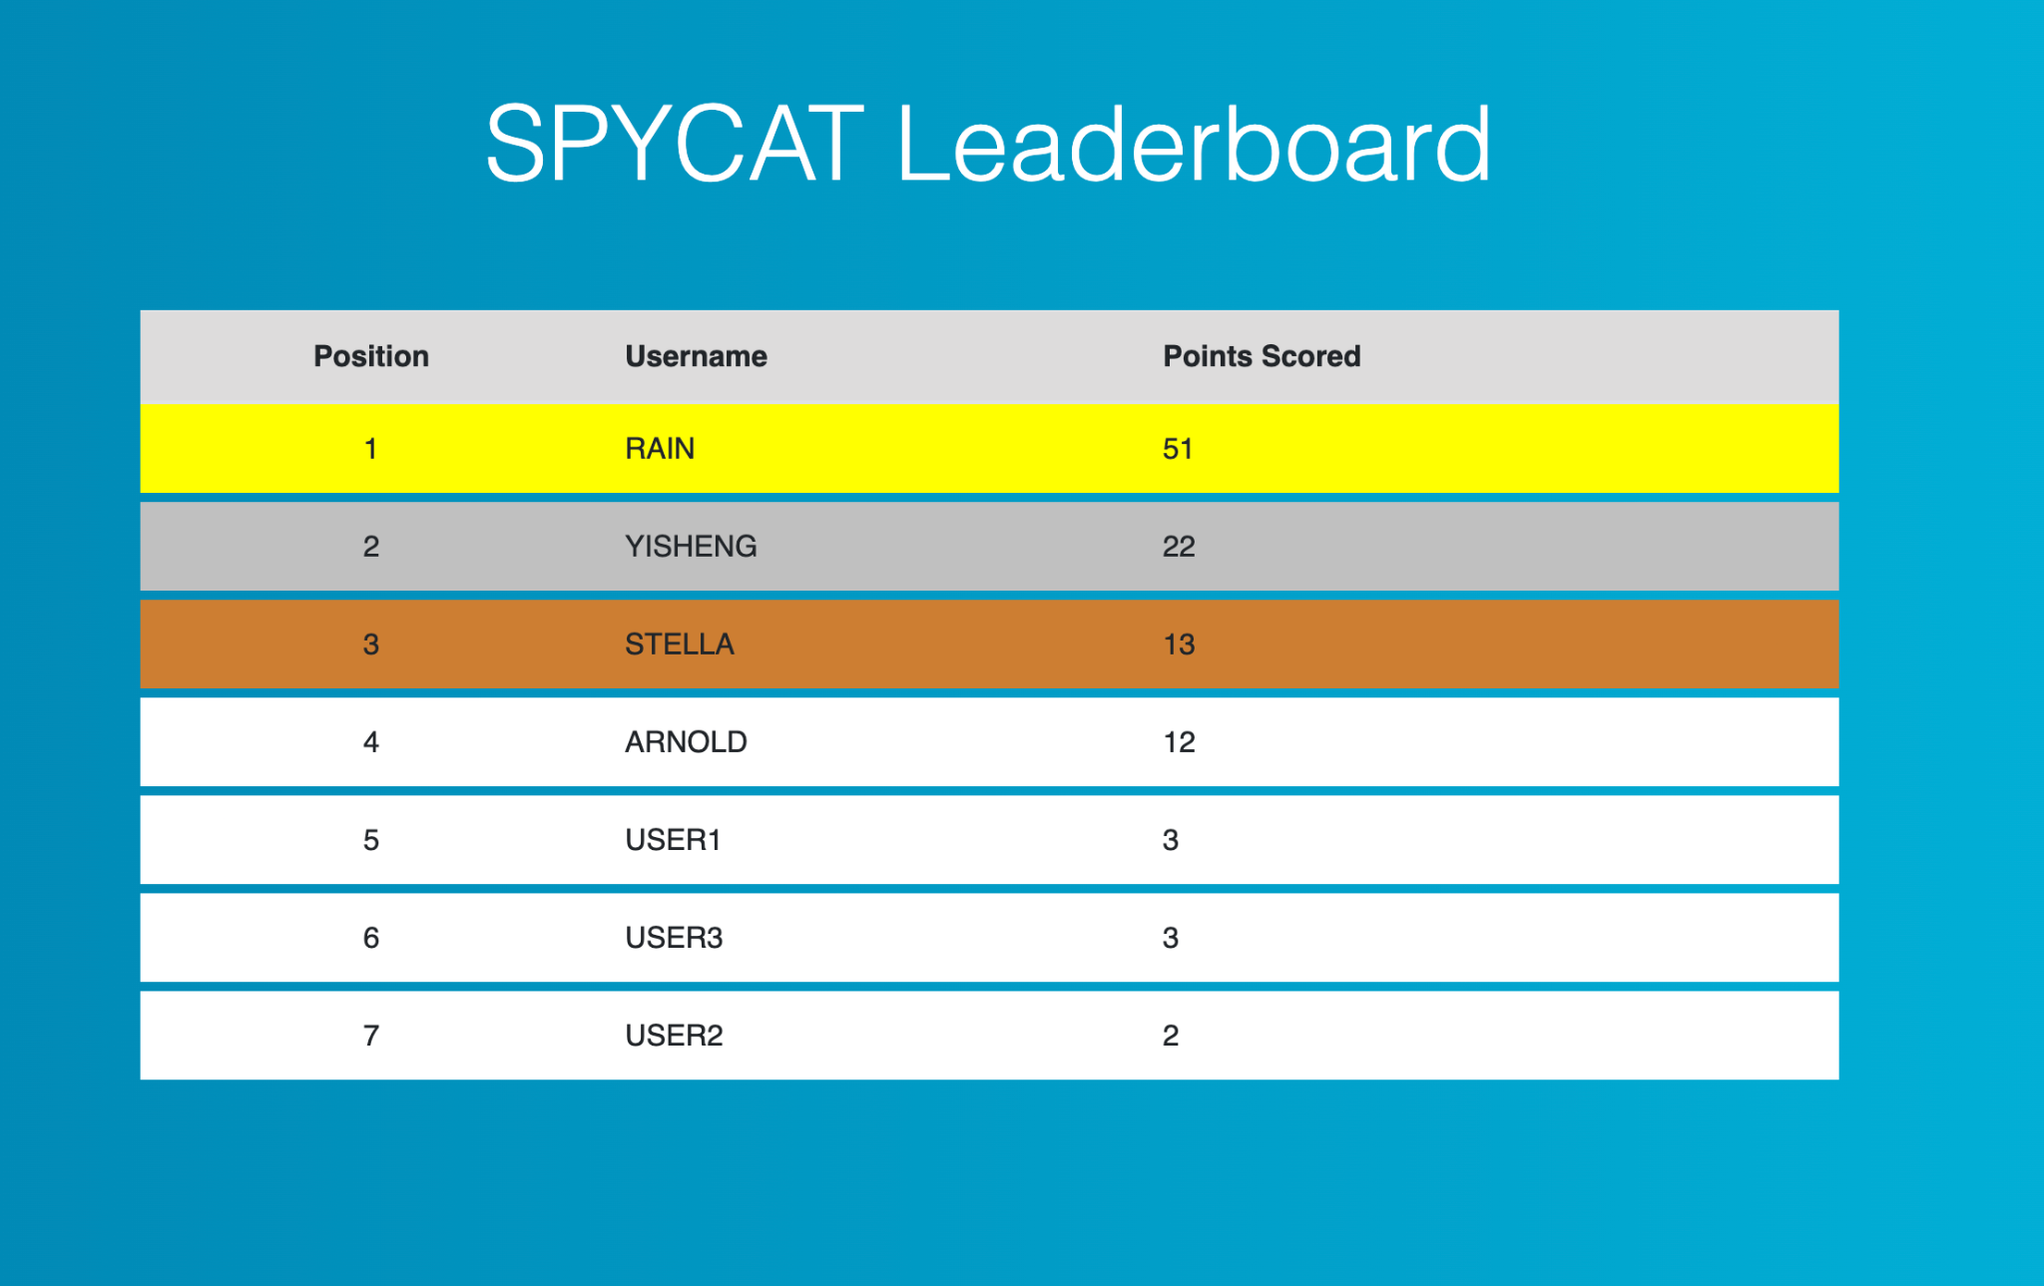
Website
Notes:
yisheng
FPGA + peripherals
API endpoint

Slide 13
Contributions
Notes:
rain
did everything together
colour legend

Slide 14
Contributions
Arnold | Rain | Stella | Yisheng
USB Webcam GPIO Camera GUI logic API integration | Backend integration EC2 Website UI Motion detection | Wifi module LUA scripts Node server Audio C code | Serial controller VGA Touchscreen GUI Website UI
Integration
Notes:
rain
De1-SoC did not have enough on-chip memory blocks to fit both our VGA controller and the frame buffer for GPIO Camera.
Need a way of communicating large chunks of data (i.e. a picture) from the FPGA to the HPS
Alternative Solution:
Using a USB Camera connected to De1-SoC interfaced with a python2 script which allowed us to run an OpenCV script to detect movement.

Slide 15
Acknowledgement
Wifi / Serial Connection: TA Jared
Motion Detection: https://pyimagesearch.com/2015/05/25/basic-motion-detection-and-tracking-with-python-and-opencv/
GUI PNG loder: https://lodev.org/lodepng/
Audio: https://people.ece.cornell.edu/land/courses/ece5760/DE1_SOC/HPS_peripherials/DSP_index.html
Notes:
arnold

Slide 16
Demo

